Slide 1
I already started. And what are you waiting for?
Global Warming Awareness Campaign
Ing. Carlos Eduardo Chávez González
Teacher: Dr. Julio Alberto García Rodriguez
Subject: Air conditioners for renewable energy sources
Cd. Guzmán, Jalisco. 6 de octubre de 2026

Slide 2
Introduction to the problem
Climate change refers to the long-term transformation of the Earth's weather conditions. The heat of the sun enters the planet and keeps everything warm enough to live comfortably.
There is a clear lack of awareness in the community regarding the issue, one of the reasons is a lack of communication between the scientific community and the population.

Slide 3
Causes of Climatic Warming
Burning of fossil fuels
Deforestation
Intensive agriculture
Industrial pollution

Slide 4
Effects

Slide 5
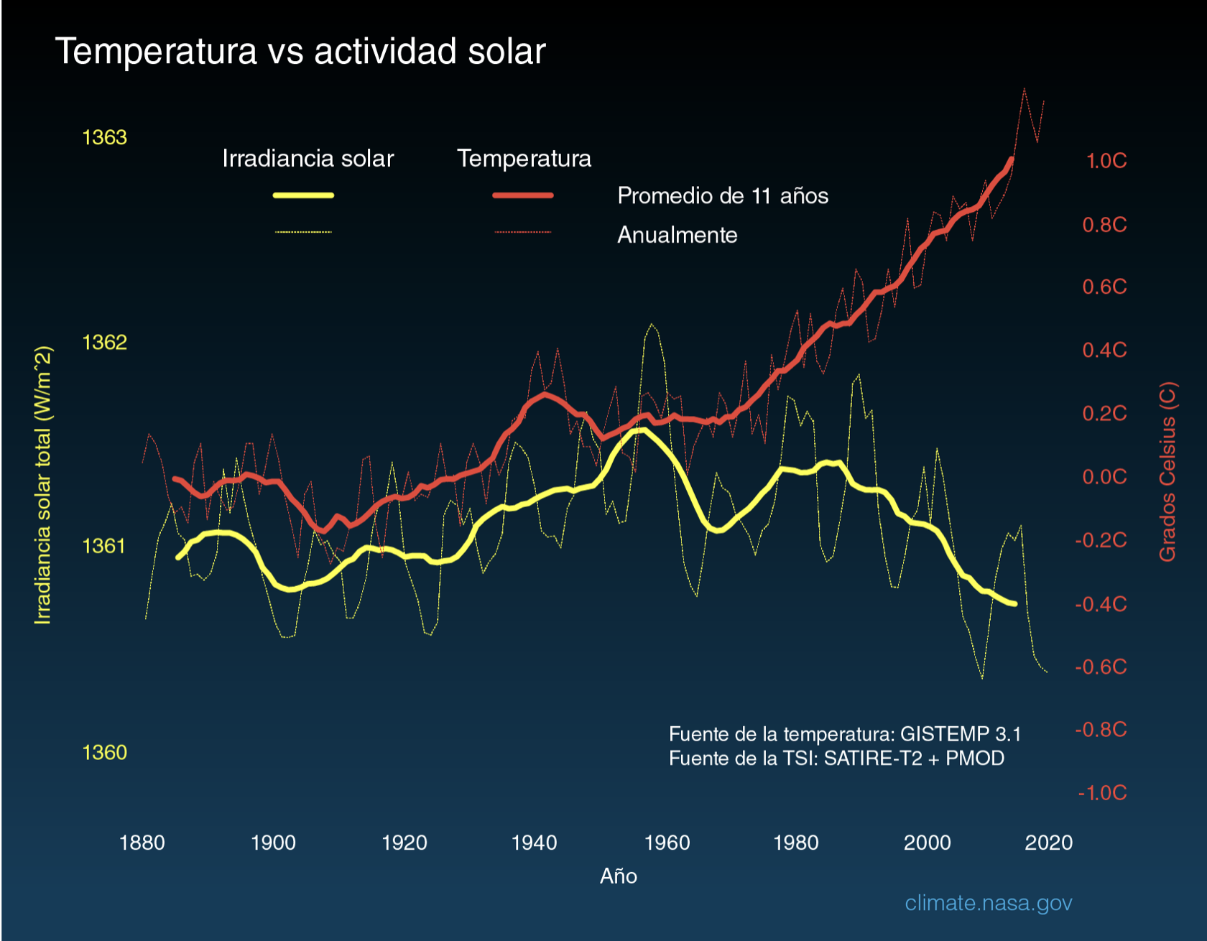
Consequences
Sea levels could rise by more than 1 to more than 6 feet in the next 70 years.
Stronger and more intense hurricanes
Droughts and heat waves.
Longer fire seasons.
Ice-free Arctic.

Slide 6
Purpose
Design of a website that contains the following contents:
Basic concepts
Historical events and their effects on climate change
Project repository to implement against climate change

Slide 7
Expected results
Generate a website with clear and easy to locate content.
Inform the community about the global problem.
Collaborate between scientific community and population for the development of scientific projects.
Generate interest in any audience.

Slide 8
Bibliography
https://ciencia.nasa.gov/cambio-climatico/los-efectos-del-cambio-climatico/
https://www.iso.org/es/cambio-climatico
https://www.wwf.org.mx/nuestro_trabajo/cambio_climatico/
https://ciencia.nasa.gov/cambio-climatico/causas/

